Slide 1
Clinical Research Facilities
Boston Children’s Hospital

Slide 2
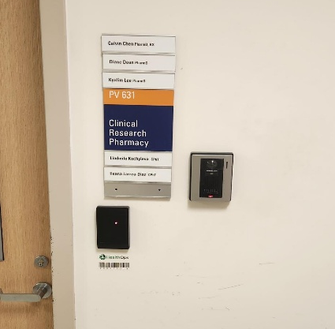
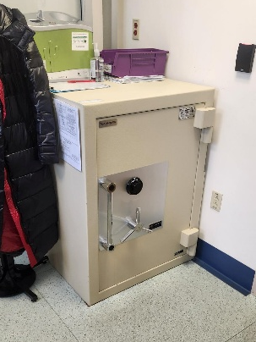
Investigational Drug Services (IDS) Research Pharmacy
The research pharmacy at BCH is only used for investigational products. IDS Pharmacy is in the dedicated research unit (CTRU).
The pharmacy is temperature-controlled PDFs of temperature logs are available upon request.
Combination safe and cold (i.e., refrigerators and freezers) storage available if needed.
Controlled substance safe with badge access
IDS Main Entrance and Badge Access

Slide 3
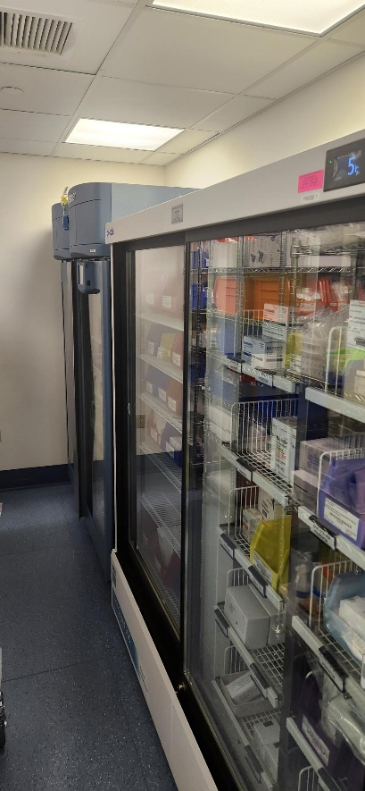
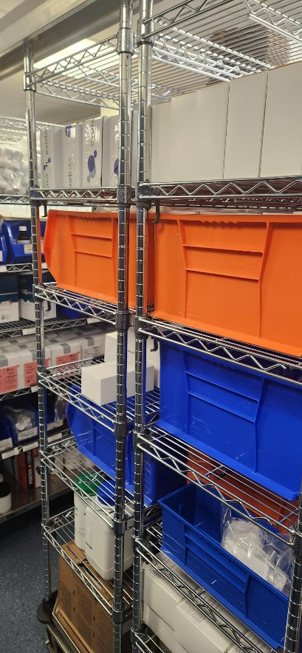
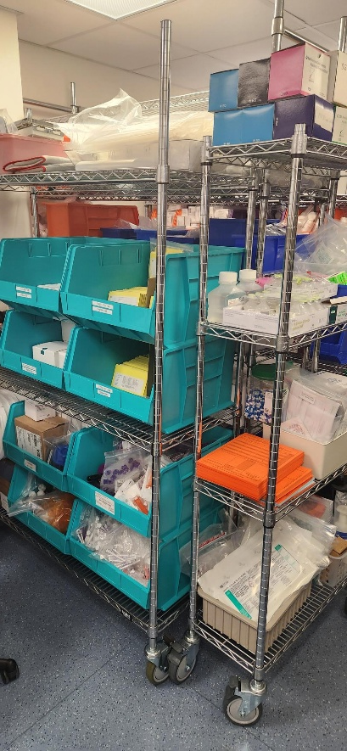
IDS Research Pharmacy (cont.)
5C Refrigerator
Supply Shelf and Bins
Supply Shelf

Slide 4
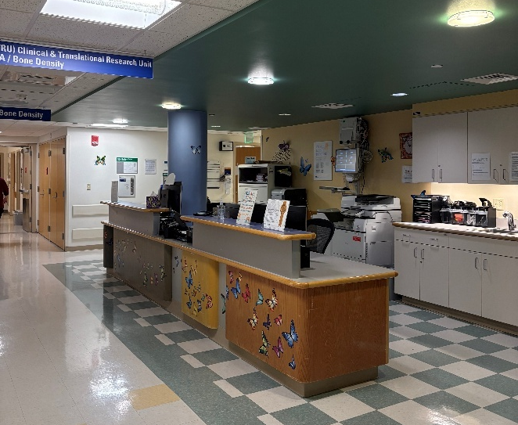
Clinical & Translational Research Unit (CTRU)
Study activities can be performed in a 6-bed designated outpatient research unit.
Each exam room is equipped with a bedside cardiorespiratory monitor to obtain vital signs. The unit has a standing scale and stadiometer and recumbent infant scale/length board and a 12-lead ECG machine.
Contains a fully stocked Code Cart for emergencies.
The department also provides inpatient services for overnight research admissions. The CTRU also provides nutrition services by licensed dieticians.
Clinic Space and Front Desk

Slide 5
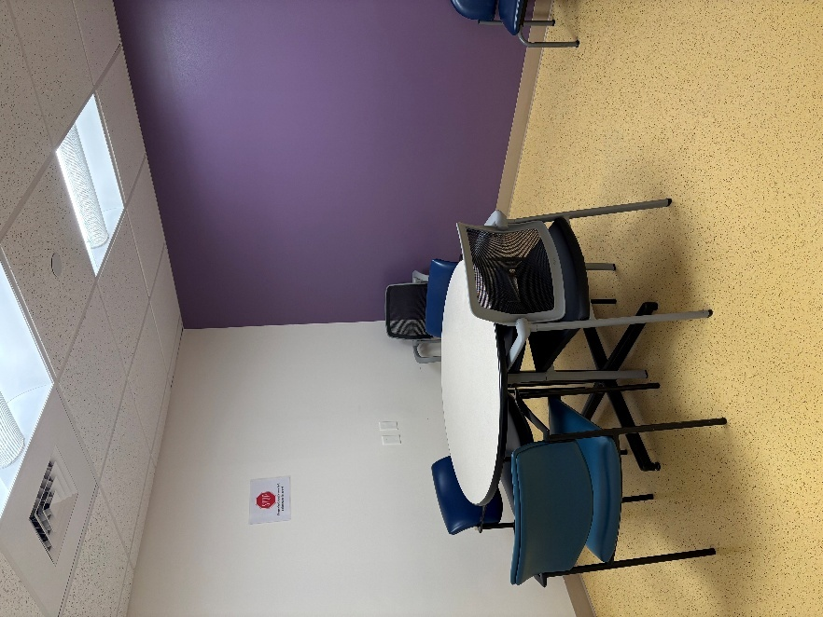
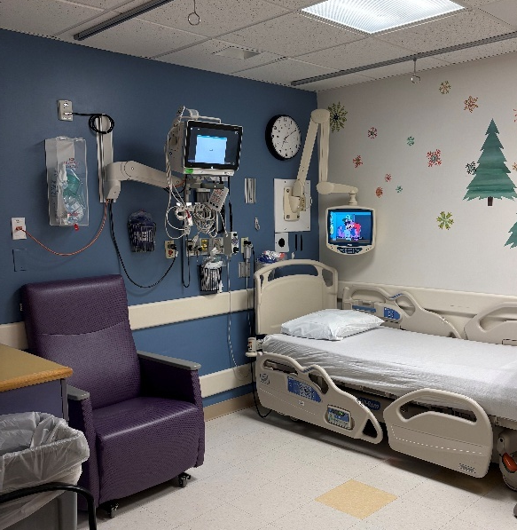
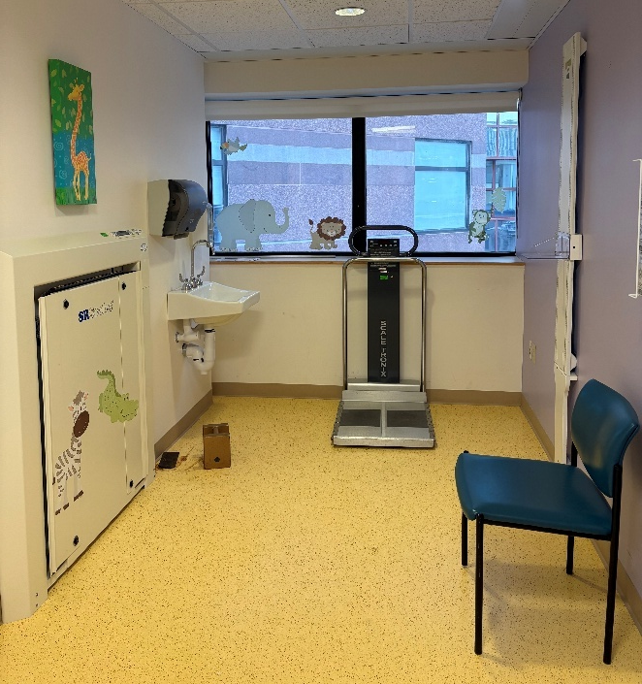
CTRU (cont.)
Consult Room
Exam Room
Standing Scale, Wheelchair Scale, Stadiometer

Slide 6
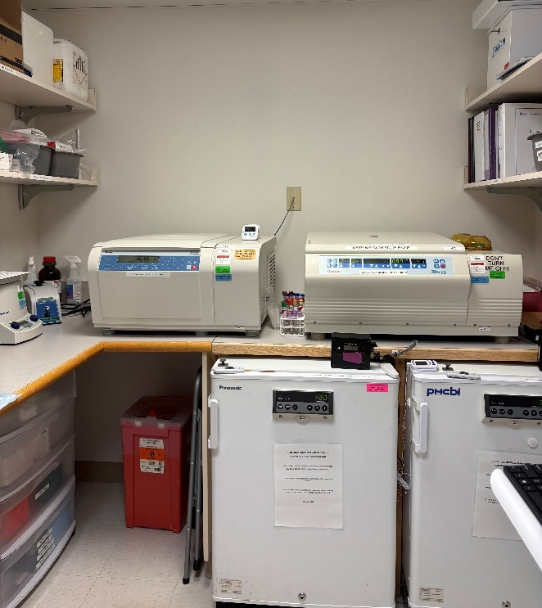
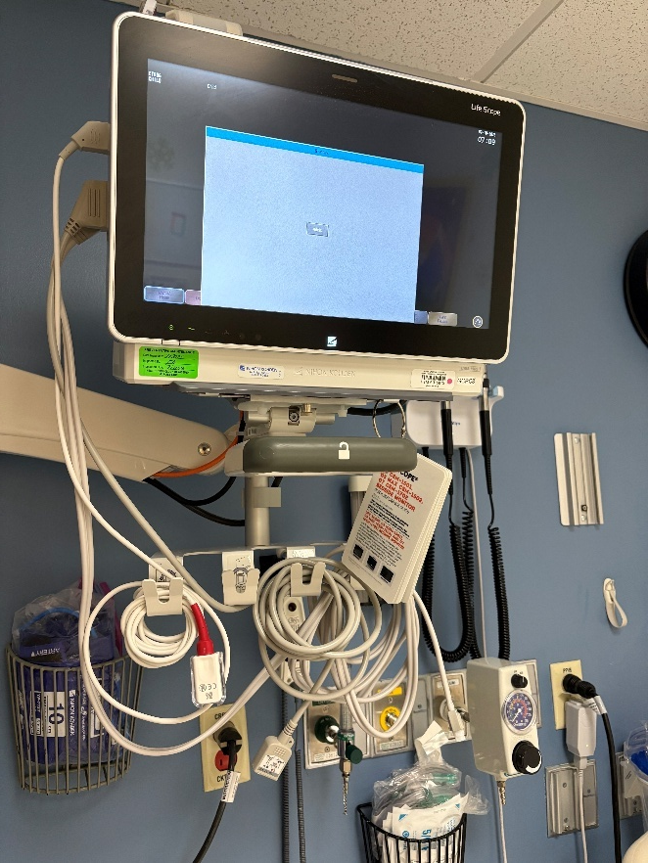
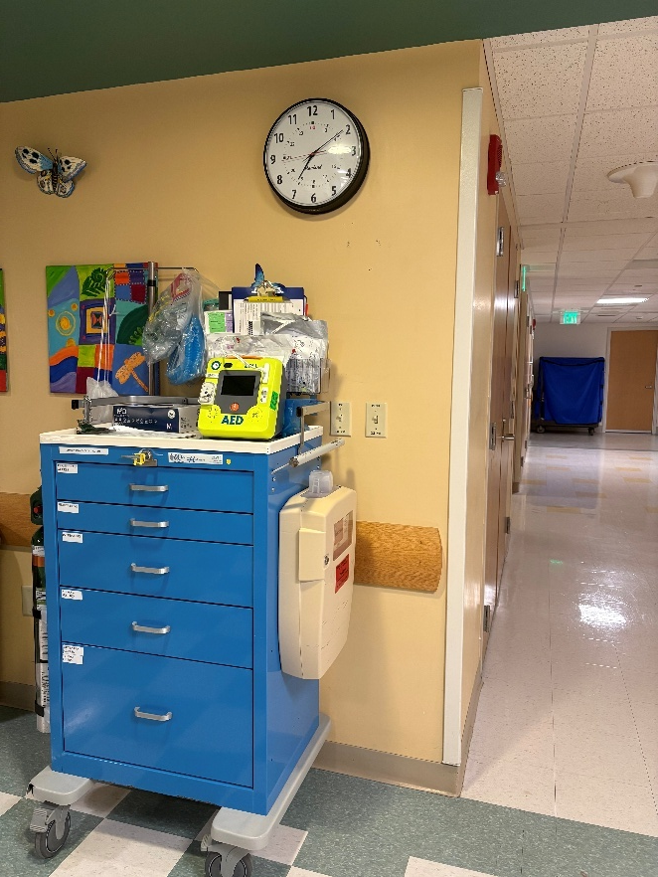
CTRU (cont.)
Bedside Cardiorespiratory Monitor and Emergency Equipment
Code Cart
Sample Processing Lab Space Centrifuges, 4C Refrigerator, and –20C Freezers

Slide 7
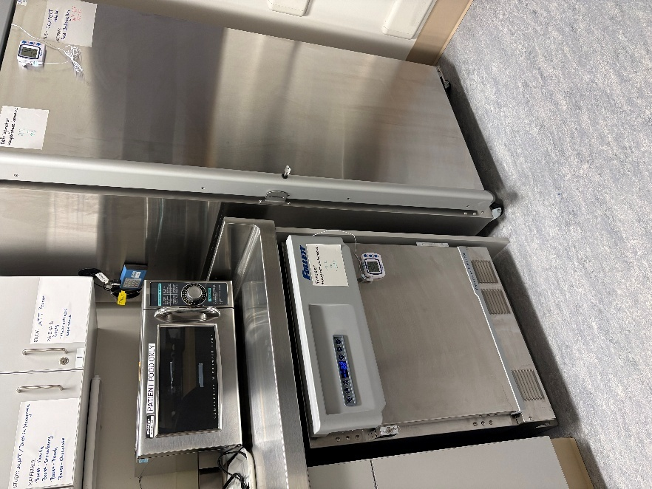
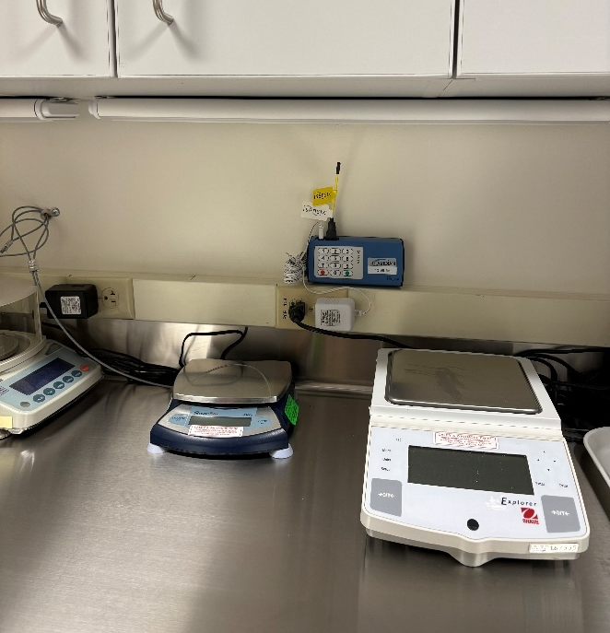
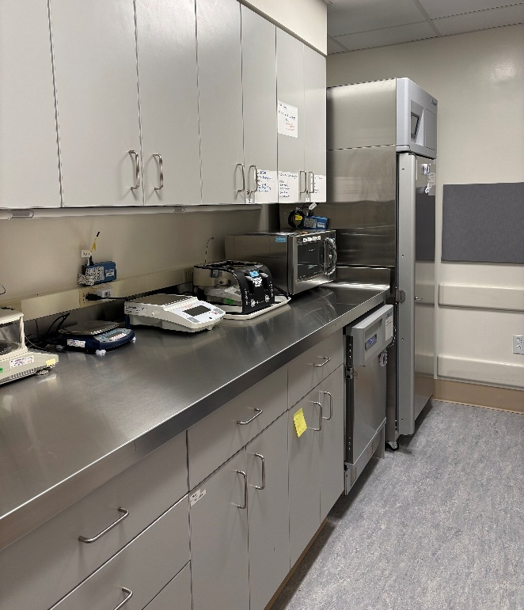
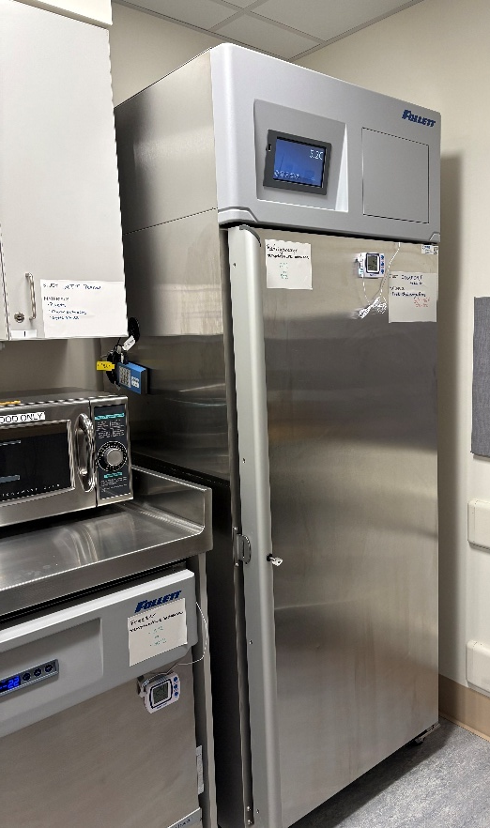
CTRU (cont.)
Nutrition Prep Space
Nutrition Preparation & Nutrition Storage Fridge and Freezer

